Slide 1
Lecture 9 - Regression Discontinuity Examples
Samuel DeWitt
Samuel DeWitt
Lecture 9 - Regression Discontinuity Examples

Slide 2
Regression Discontinuity Examples
Yoruk and Yoruk (2011) - Minimum Legal Drinking Age (MLDA)
Crost and Rees (2013) - New Estimates
Yoruk and Yoruk (2013) - Revision
Samuel DeWitt
Lecture 9 - Regression Discontinuity Examples

Slide 3
Why is 21 the legal drinking age in the US?
▶ Most states voluntarily set age at 21 until the 1970s
▶ Some states lowered the MLDA during the 1970s to as low as 18
▶ Drunk driving and traffic fatalities became prominent issues in early 1980s
▶ Reagan signs National Minimum Drinking Age Act in 1984
Samuel DeWitt
Lecture 9 - Regression Discontinuity Examples

Slide 4
What is the Effect of MLDA?
▶ We think. . . :
Higher MLDA reduces drunk driving and traffic fatalities
Higher MLDA reduces teen drinking (but does not preclude it)
Higher MLDA reduces teen smoking (tobacco and marijuana)
▶ We know that. . .
These impacts were largely driven by early-adoption states of 21 as MLDA
Samuel DeWitt
Lecture 9 - Regression Discontinuity Examples

Slide 5
Complications for Causal Effects
▶ How we try to estimate causal effects of laws
We assume individual-level behavior is not a cause of law, but a consequence
This can result in exogeneity in the relationship between law and behavior
We can then capitalize on cross-state differences in the type and timing MLDA laws
▶ Is MLDA exogenous?
Probably not - Law is not unrelated to teen drinking behavior
Samuel DeWitt
Lecture 9 - Regression Discontinuity Examples

Slide 6
Does MLDA Have a True Causal Effect on Smoking?
Yoruk and Yoruk (2011)
▶ Use age as a running variable to estimate within-person causal effect
I.e., what is the effect of being able to consume alcohol legally on smoking behaviors?
▶ Measure of age
Obtained exact birth and interview dates (public data gives you month at best)
Calculated the numbers of days pre/post turning 21 as of the date of the latest NLSY97 interview
Samuel DeWitt
Lecture 9 - Regression Discontinuity Examples

Slide 7
Does MLDA Have a True Causal Effect on Smoking? (cont)
▶ Age bandwidths (multiple)
480 days
240 days
120 days
60 days
30 days
▶ Estimation
Local linear regressions above/below bandwidth
▶ This just means the regressions are estimated right below and above the cutoffs according to the chosen bandwidths.
Samuel DeWitt
Lecture 9 - Regression Discontinuity Examples

Slide 8
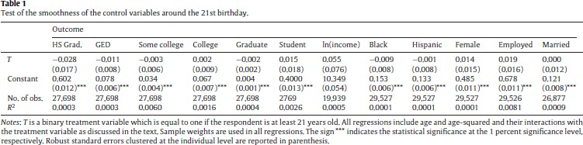
Yoruk and Yoruk (2011) - Covariate Balance
Samuel DeWitt
Lecture 9 - Regression Discontinuity Examples

Slide 9
Yoruk and Yoruk (2011) - Covariate Balance
Just a slide for listing what I say about Table 1
▶ Ignore significance of constant coefficient - this is mainly indicating a consistent estimate of where the line crosses the y-axis
▶ Most importantly - no covariates appear to be imbalanced around the 21st birthday cutoff
▶ This is largely expected - birthdate is not something people will try to manipulate for the purposes of a survey
▶ However, this does not imply that youth do not try to manipulate their apparent age to get access to alcohol!
Samuel DeWitt
Lecture 9 - Regression Discontinuity Examples

Slide 10
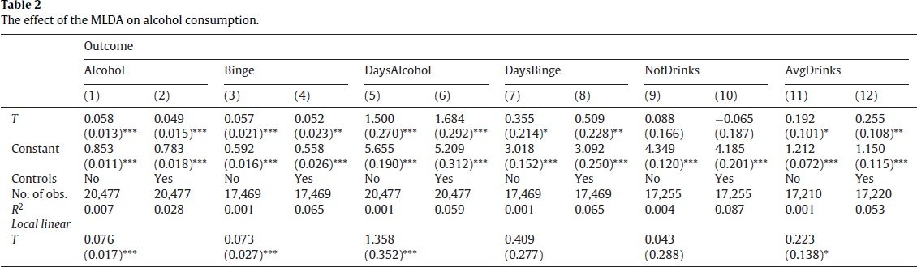
Yoruk and Yoruk (2011) - Effect of MLDA on Alcohol Consumption
Samuel DeWitt
Lecture 9 - Regression Discontinuity Examples

Slide 11
Yoruk and Yoruk (2011) - Effect of MLDA on Alcohol Consumption
Another slide for listing what I say about Table 2
▶ Underlying question being tested is if the MLDA has an effect on alcohol use above/below the cutoffs with bandwidth of 240 days.
▶ Results are about what we would expect:
Use of alcohol (binary) increases
Binge drinking (binary) also increases
Days using alcohol increases along with days of binge drinking
No effect on number of total drinks consumed, though
Samuel DeWitt
Lecture 9 - Regression Discontinuity Examples

Slide 12
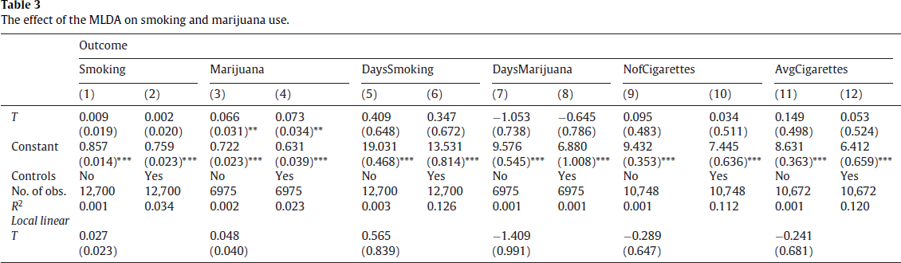
Yoruk and Yoruk (2011) - Effect of MLDA on Smoking Habits
Samuel DeWitt
Lecture 9 - Regression Discontinuity Examples

Slide 13
Yoruk and Yoruk (2011) - Effect of MLDA on Smoking Habits
Another slide for listing what I say about Table 3
▶ Question being tested is whether legal access to alcohol also affects smoking (tobacco/marijuana) habits
▶ Results are a little strange
No effect on probability of smoking tobacco or amount, for that matter
About a 7% increase in the probability of using marijuana
Seems to contradict anecdotal evidence re:amplification of tobacco use and the alternative interpretation of marijuana being the gateway drug.
Samuel DeWitt
Lecture 9 - Regression Discontinuity Examples

Slide 14
Crost and Rees (2013) - Why It Is Important to Read Data Codebooks Carefully
The evidence from Yoruk and Yoruk (2011) was somewhat surprising, but Crost and Rees (2013) provide a good explanation for why the original results were somewhat counterintuitive.
▶ Some markers for why it looked like something was wrong:
Reported marijuana use in the past 30 days in Yoruk and Yoruk was very high (76%!!!)
Sample drops precipitously in marijuana discontinuity model (about 20,000 observations lost)
From this, Crost and Rees (2013) surmise that Yoruk and Yoruk (2011) ignored an important lead-in question. In fact, they accidentally restricted their sample only to those that used marijuana since the last survey!
Samuel DeWitt
Lecture 9 - Regression Discontinuity Examples

Slide 15
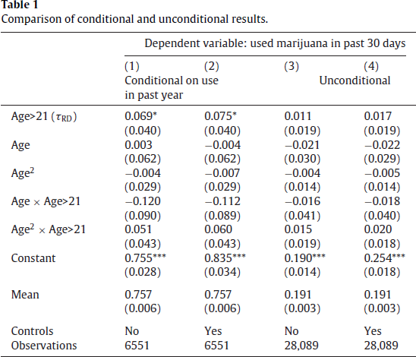
Crost and Rees (2013) - Corrected Findings
Samuel DeWitt
Lecture 9 - Regression Discontinuity Examples

Slide 16
Crost and Rees (2013) - Corrected Findings
Another slide for listing what I say about Table 1 from Crost and Rees (2013)
▶ Conditional estimates are only for youth who have used marijuana since the last interview
▶ Unconditional estimates are for all youth regardless of prior marijuana use
▶ What changes?
– The 6-7% increase in marijuana use in the past 30 days disappears!
Samuel DeWitt
Lecture 9 - Regression Discontinuity Examples

Slide 17
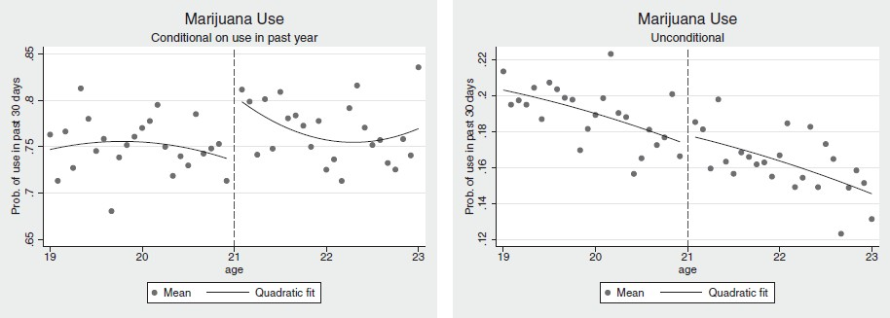
Crost and Rees (2013) - Corrected Findings (Figure)
Samuel DeWitt
Lecture 9 - Regression Discontinuity Examples

Slide 18
Crost and Rees (2013) - Corrected Findings (Figure)
So, are alcohol and marijuana use interdependent?
▶ Kind of. . . .but not in the way Yoruk and Yoruk thought of it
MLDA does not have an impact on the probability of using marijuana at all
MLDA does look like it may have an impact on the recency of using marijuana
if you have used marijuana before
Samuel DeWitt
Lecture 9 - Regression Discontinuity Examples

Slide 19
Yoruk and Yoruk (2013) - Revised Estimates
Yoruk and Yoruk (2013) is a response to Crost and Rees (2013) and re-reports revised findings for all of the hypotheses tested in their original study.
▶ As an aside, I chose this series of papers because:
I figured you might be interested in MLDA laws given your average ages
It’s a good example of a collegial back and forth where incorrect scientific evidence is corrected (this is an example of science working properly!)
A reminder not to take scientific evidence at face value but also not to dismiss it
entirely.
▶ It’s important to be skeptical of surprising findings - sometimes there’s a good reason for this
Samuel DeWitt
Lecture 9 - Regression Discontinuity Examples

Slide 20
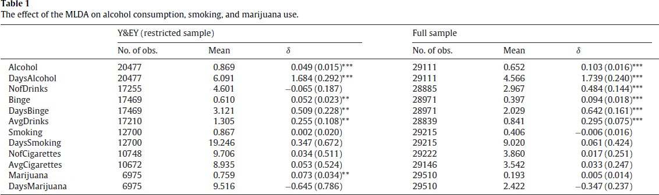
Yoruk and Yoruk (2013) - Revised Estimates
Samuel DeWitt
Lecture 9 - Regression Discontinuity Examples

Slide 21
Yoruk and Yoruk (2013) - Revised Estimates
▶ So, a brief conclusion:
MLDA has a clear impact on the probability and frequency of alcohol use (as anticipated)
But, it does not have an impact on the probability and frequency of smoking or marijuana use in the unconditional samples
▶ Its effect on marijuana use may be conditional though
Samuel DeWitt
Lecture 9 - Regression Discontinuity Examples

Slide 22

The End
Samuel DeWitt
Lecture 9 - Regression Discontinuity Examples

